Slide 1
FRON-TEND PROJECT
ON
JOB PORTAL
  PRESENTED BY
  P.AMULYA

Slide 2
ABSTRACT
The Job Portal is a web-based application designed to connect job seekers with employers in a simple and efficient way. It allows job seekers to create profiles, search for jobs, and apply for suitable vacancies. Employers can post job openings, manage applications, and find qualified candidates based on their requirements.
This project is developed using HTML, CSS, and JavaScript for the frontend, providing a responsive and user-friendly interface. The main objective of the job portal is to simplify the recruitment process, save time for both employers and job seekers, and provide easy access to employment opportunities through a single platform.

Slide 3
INTRODUCTION
The job portal is a web-based application developed to simplify the recruitment process by connecting job seekers and employers on a single platform. In today's digital world, online job portals have become one of the most effective ways for companies to find skilled candidates and for job seekers to discover suitable career opportunities.This project provides a user-friendly interface where job seekers can browse available jobs, view job descriptions, search for jobs based on different criteria, and apply for positions. Employers can post job vacancies, display job requirements, and manage applications efficiently. The portal helps reduce the time and effort involved in the traditional recruitment process by making job information easily accessible.

Slide 4
OBJECTIVE
To develop a user-friendly web-based job portal that connects job seekers with employers.
To enable employers to post job vacancies and manage job listings efficiently.
To allow job seekers to search, view, and apply for suitable job opportunities.
To simplify and speed up the recruitment process by providing an online platform.
To reduce the time and effort required for both employers and candidates during hiring.
To provide an attractive, responsive, and easy-to-use interface using html, css, and javascript.
To improve accessibility so users can access job information anytime and from anywhere.
To create a platform that enhances communication between employers and job seekers.

Slide 5
SAMPLE CODE
<!-- HTML -->
<div class="job-card">
<h2>Frontend Developer</h2>
<p>Company: ABC Technologies</p>
<button onclick="applyJob()">Apply Now</button>
</div>
<!-- CSS -->
<style>
.job-card{
padding:20px;
border-radius:10px;
box-shadow:0 0 10px gray;
}
button{
background:green;
color:white;
}
</style>
<!-- JavaScript -->
<script>function applyJob(){
alert("Application Submitted Successfully!");
}
</script>

Slide 6
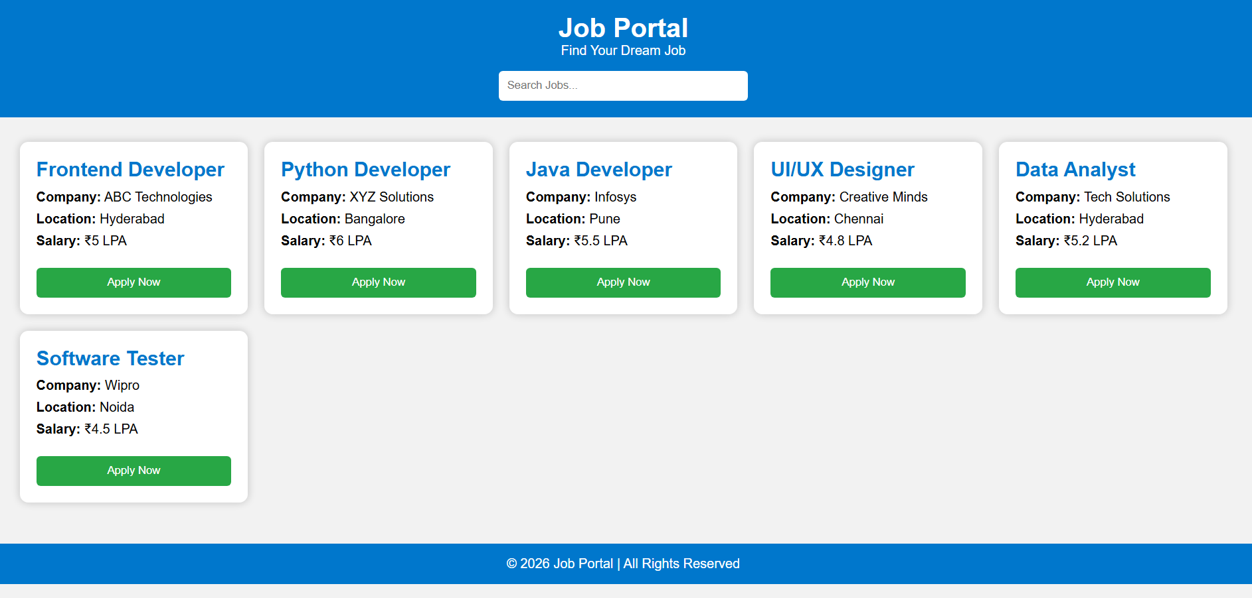
OUTPUT:

Slide 7
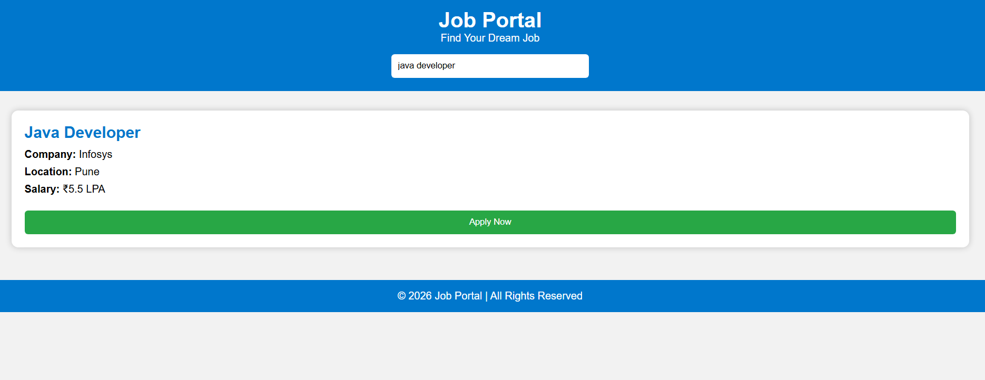

Slide 8
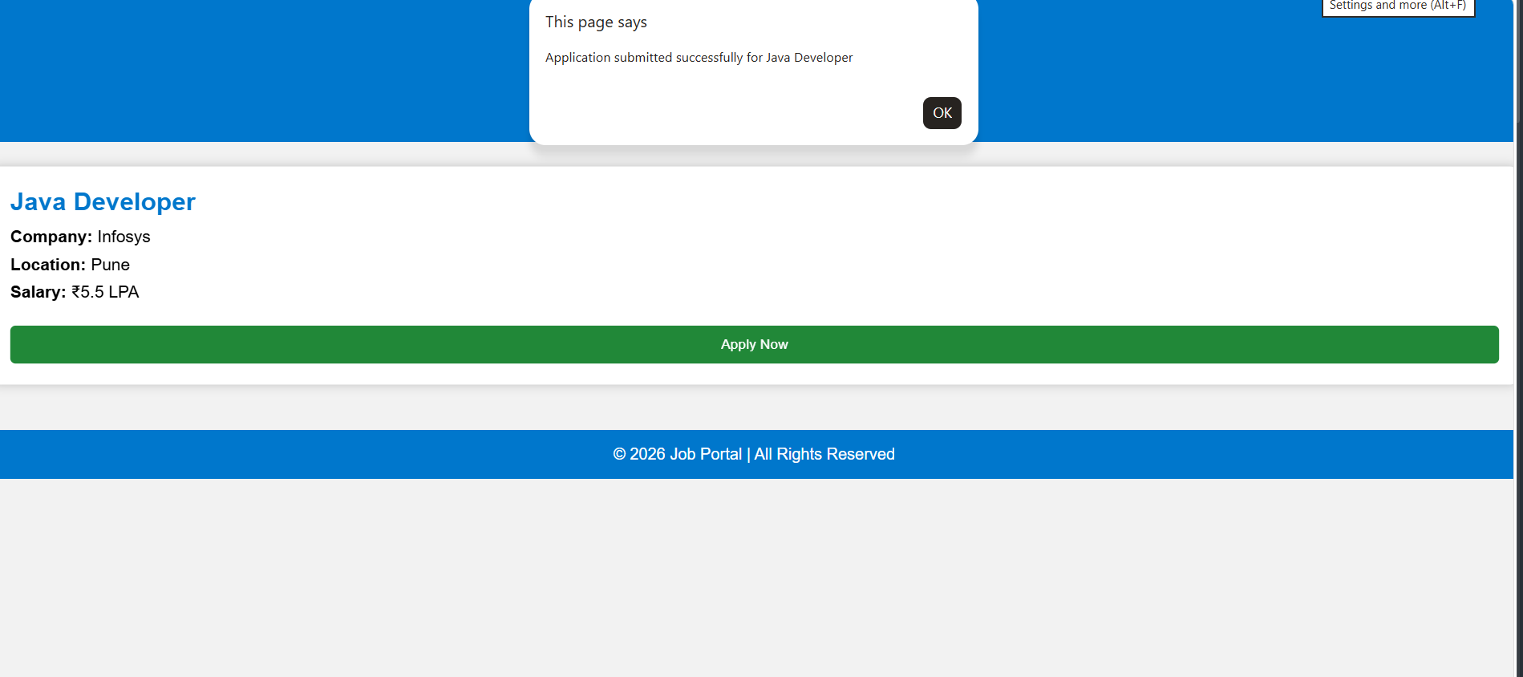

Slide 9


